Slide 1
Quantitative comparison of cross polar cap potential as derived from AMIE, DMSP, SuperDARN
Elsayed R. Talaat¹, Marc Hairston², Geoff Crowley³,
Robin Barnes¹, Thomas Sotirelis¹
¹Johns Hopkins University Applied Physics Laboratory
²University of Texas, Dallas
³ASTRA
elsayed.talaat@jhuapl.edu

Slide 2
Chasing AMIE
Data used
SuperDARN derived CPCP with propagated solar wind – product we provide on the website
DMSP observed CPCP – 1997-2007
AMIE derived CPCP w/ mag – 1991-2002, 2006, 2007
AMIE derived CPCP w/ mag, DMSP – 2000-2005
AMIE derived CPCP w/ mag, DMSP, SuperDARN – 2001-2005
AMIE derived CPCP w/ mag, SuperDARN – 2006,2007
Some large issues
Data sets and models cover different times
AMIE with DMSP and AMIE with DMSP, SD not vetted
Some progress AMIE coverage doubled since last year

Slide 3
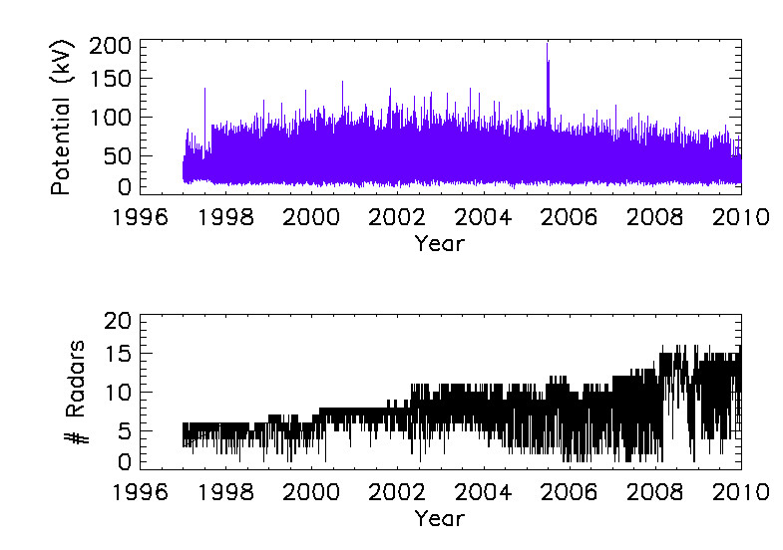

Slide 5
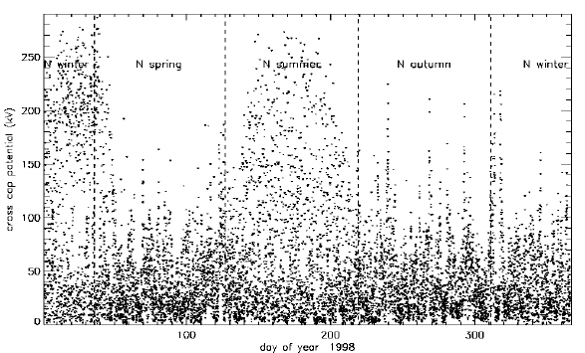
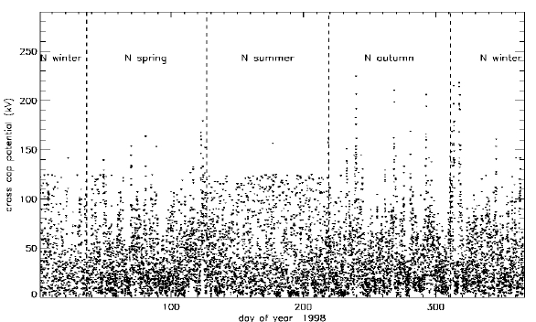
DMSP vetting
Marc Hairston has done extensive vetting of the data, removing light ion contamination

Slide 6
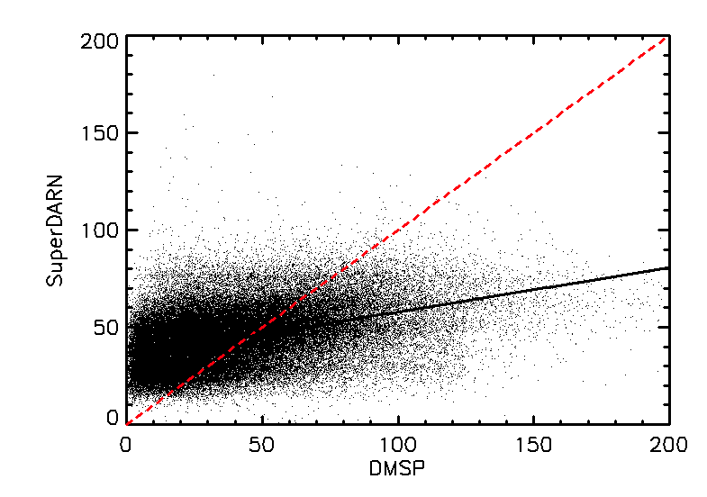
DMSP vs SD

Slide 7
AMIE vs SD

Slide 8
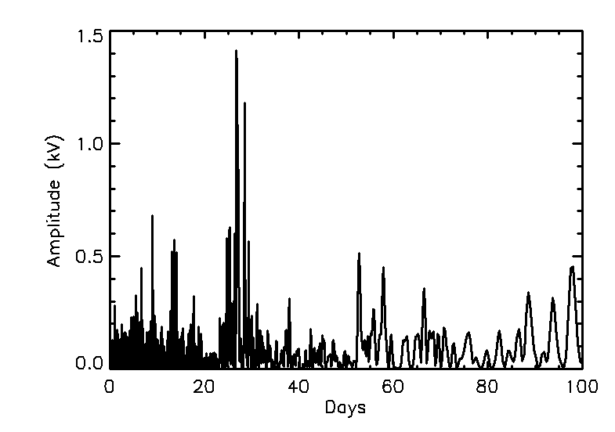
Periodicities in SuperDARN

Slide 9
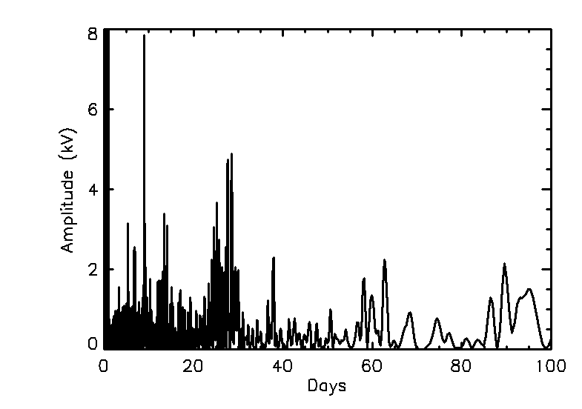
Periodicities in DMSP

Slide 10
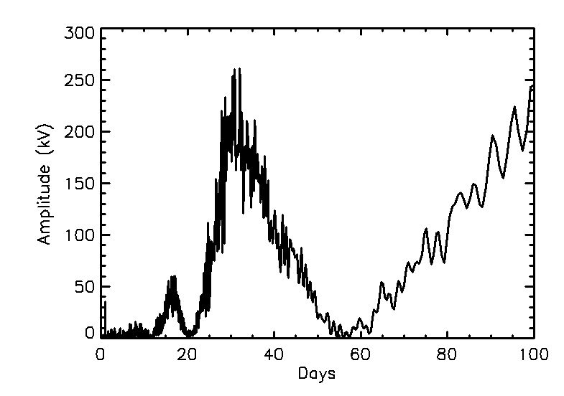
Periodicities in AMIE w/o SD

Slide 11
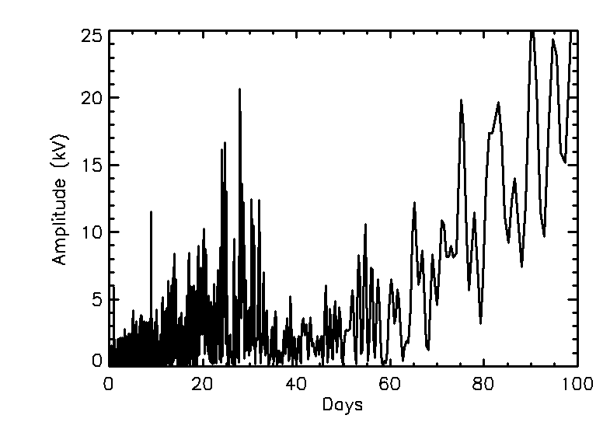
Periodicities in AMIE w/o SD

Slide 12
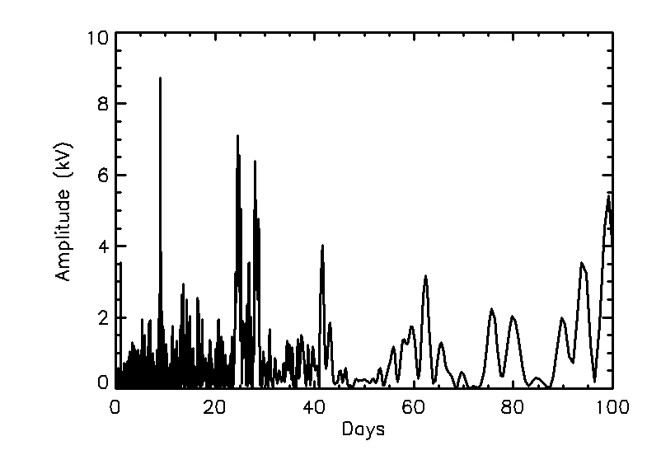
Periodicities in AMIE w/ DMSP and SD

Slide 13
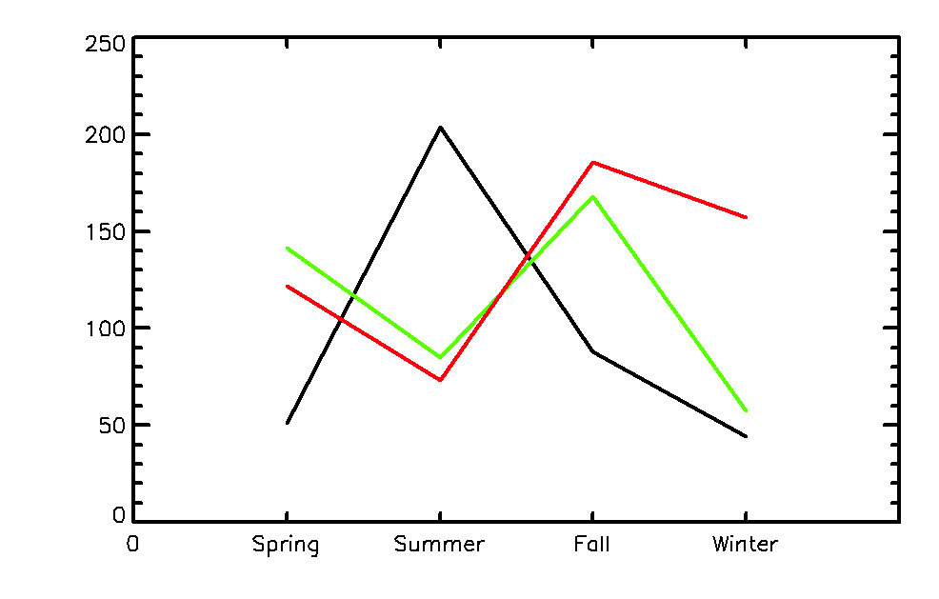
Seasonal Analysis of Large Storms

